Slide 1





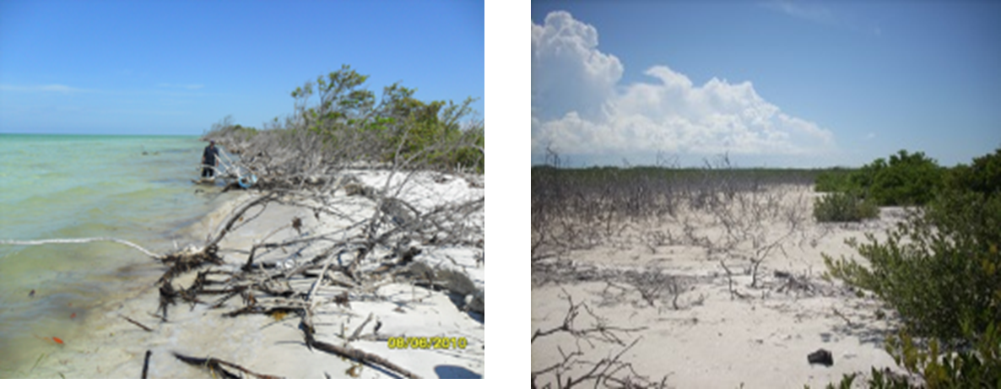
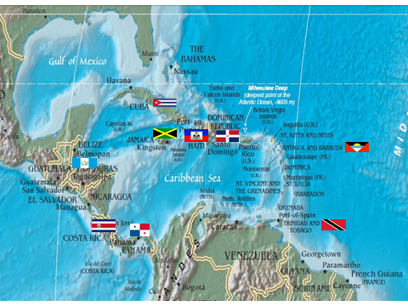
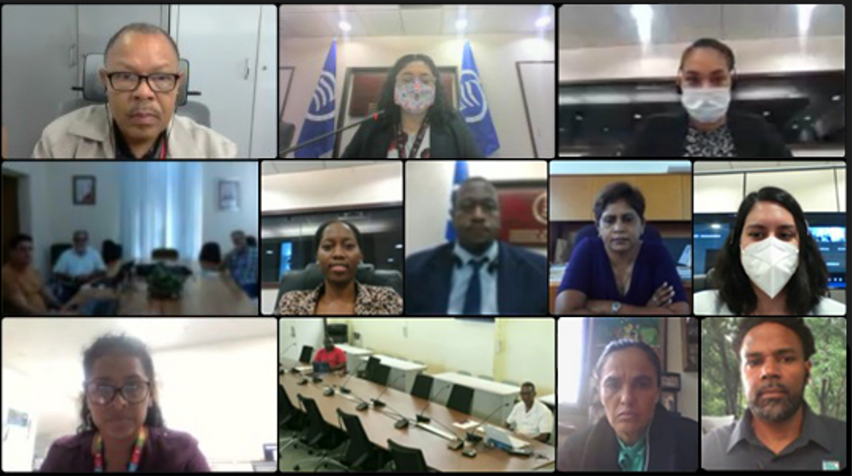
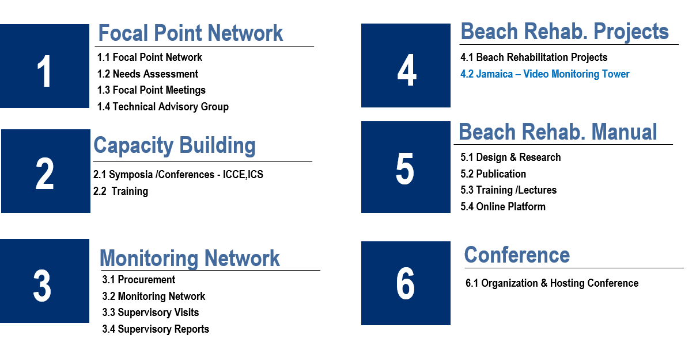
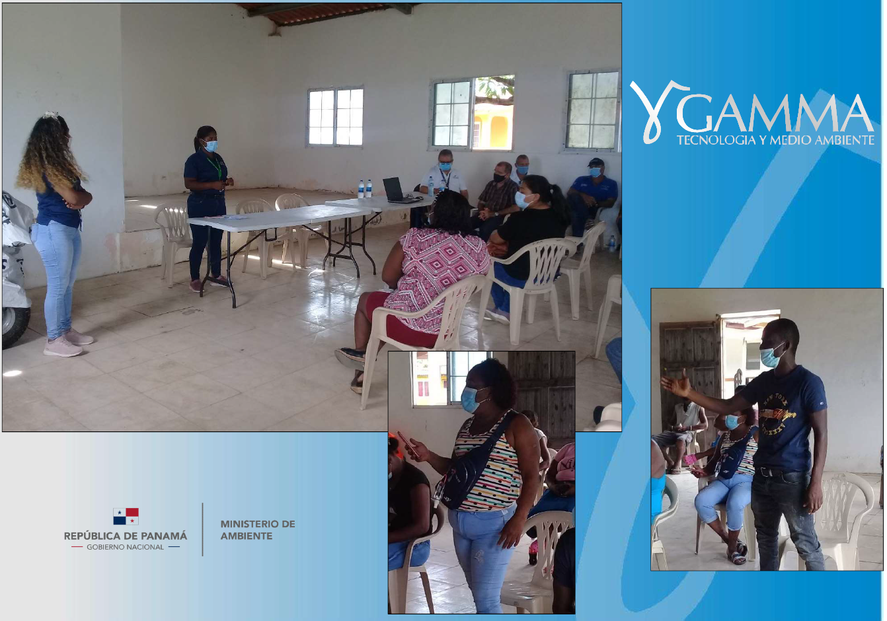
Paper #: 1211 EROSION PROCESS IN THE CARIBBEAN SANDY BEACHES
José Luis Juanes, Institute of Marine Sciences, Cuba juanesjoseluis4@gmail.com
Colin Peter Jack, Association of Caribbean States. cjack@acs-aec.org
THE PROBLEM
Beach erosion is a widespread phenomenon on Caribbean beaches, with rates of coastline retreat between 2.2 and 0.5 m/year and higher reports in some areas. Different investigations indicate the combination of natural and anthropogenic causes and highlight the current influence of climate change related sea level rise. It is recorded as a generalizing trend the landward displacement of the beach profile, with sand transfer above the dunes and sand bars in a process that fits better the model proposed by Dean and Maurmeyer (1983) than the recognized model by Brunn (1962). Photos 1 and 2 show an example of the occurrence of this process.
Photos 1 and 2. shows Transport
of sand from the beach to the lagoon. Cayo Fragoso. North Coast of Cuba.
2. THE SANDY SHORELINES PROJECT
With the aim of deepening this research, and considering the environmental and socio-economic importance of the impact of beach erosion in the countries of the region, the Association of Caribbean States (ACS), in collaboration with the International Collaborative Agency of the Republic of South Korea (KOICA) and the Korean Institute of Oceanic Science and Technology (KIOST), have been developing since 2017 the project: “Impact Assessment of Climate Change on the Sandy Shorelines of the Caribbean. Alternatives for its control and resilience” (Sandy Shorelines) with the participation of 9 countries:
General Objective. Contribute to the definition and application of the best practices for the preservation and rehabilitation of beaches in the face of the effects of climate change in the Caribbean
REGIONAL NETWORK
FOCAL POINT MEETINGS & PUBLIC CONSULTATIONS
PROJECT COMPONENTS
UNDERSTAND…….. COLLECT DATA………………… MONITOR ……………………..PRESERVE & PROTECT……

Slide 2
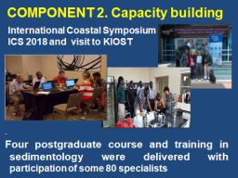
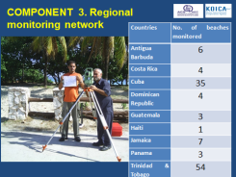
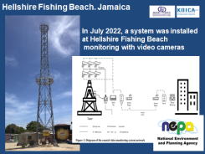
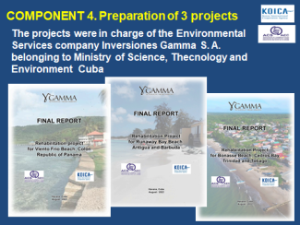
Paper #: 1211 EROSION PROCESS IN THE CARIBBEAN SANDY BEACHES
José Luis Juanes, Institute of Marine Sciences, Cuba juanesjoseluis4@gmail.com
Colin Peter Jack, Association of Caribbean States. cjack@acs-aec.org
3. RESULTS
TRAINING OF EXPERTS MONITORING OF “AT RISK” SHORELINES
ADVANCED BEACH MONITORING ,JAMAICA PROTOTYPE PROJECTS PANAMA, ANTIGUA & TRINIDAD
. THE SANDY SHORELINES PROJECT CONCLUDES IN JUNE 2023……
THE PARTICIPATING COUNTRIES CAN LOOK FORWARD TO…….
DISTRIBUTION OF COASTAL MONITORING EQUIPMENT
COMPILATION OF A CARIBBEAN BEST PRACTICE BEACH REHABILITATION MANUAL
INTERACTICE ONLINE PLATFORM WITH GIS MAPPING OF CARIBBEAN SHORELINES
HOSTING OF A BEACH PRESERVATION CONFERENCE

